Slide 1

MIND+
SELF-MONITORING AND ANONYMOUS
COUNSELLING BASED DIGITAL COMPANION FOR
ACADEMIC STRESS MANAGEMENT
25-26J-480

Slide 2
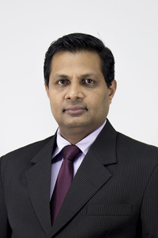



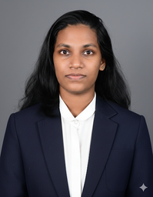



MEET OUR
TEAM MEMBERS
Prof. Samantha Thelijjagoda
Supervisor
Ms. Chamali Pabasara​
Co-Supervisor
Ms. Sachini Pathiraja (Clinical Psychologist)​
External Supervisor​
Raajapaksha R.N.D.K.
IT22315632
Jayasooriya J.K.B.A.P.
IT22358684
Gunathilaka M.A.S.
IT22341136
Hettiarachchi E.I.
IT22004390

Slide 3
SELF-MONITORING AND ANONYMOUS COUNSELLING BASED DIGITAL COMPANION FOR ACADEMIC STRESS MANAGEMENT
PROBLEM STATEMENT: ACADEMIC STRESS
Increasing Academic Demands
Prolonged Academic Pressure
Lack of Effective Stress-Regulation Strategies
Chronic Academic Stress
Burnout & Emotional Exhaustion
Decline in Academic Performance
Long-Term Physical & Psychological Impact
25-26J-480

Slide 4
SELF-MONITORING AND ANONYMOUS COUNSELLING BASED DIGITAL COMPANION FOR ACADEMIC STRESS MANAGEMENT
TARGET USERS AND BENEFICIARIES
PRIMARY
SECONDARY
Age 16 to 30,
University and college students
Academically committed learners facing high academic pressure
Students preparing for exams, projects, and career transitions
Educational Sector
Improved student performance and retention
Families
Reduced emotional and financial strain
Society
Healthier, more resilient future professionals
25-26J-480

Slide 5
SELF-MONITORING AND ANONYMOUS COUNSELLING BASED DIGITAL COMPANION FOR ACADEMIC STRESS MANAGEMENT
RESEARCH GAP & OBJECTIVES
RESEARCH GAP
MAIN OBJECTIVE
Most apps are reactive, not predictive
Limited integration of academic workload as a stress trigger
Mood tracking and journaling tools are standalone and not intelligent
Lack of personalized stress fingerprinting
Insufficient real-time emotion detection
Weak anonymous and stigma-free support pathways
Limited use of AI-driven proactive intervention models
To design and develop a mobile-based application that enables university students to monitor, predict, visualize, and manage academic stress through self-monitoring, machine learning–based forecasting, adaptive visualization, and anonymous counseling support.
25-26J-480

Slide 6
SELF-MONITORING AND ANONYMOUS COUNSELLING BASED DIGITAL COMPANION FOR ACADEMIC STRESS MANAGEMENT
SOLUTION OVERVIEW OF MIND+
An AI-driven, privacy-preserving digital companion that enables continuous monitoring, prediction, and personalized management of academic stress among students.
FUNCTIONAL REQUIRMENTS
NON-FUNCTIONAL REQUIRMENTS
User registration & secure profile management
Daily mood check-ins & voice/text journaling
Emotionally intelligent chatbot with task suggestions
Anonymous community forum & emergency escalation
Academic stress heatmap and stress prediction
AI-based emotion detection
Strong data security & encrypted communication
Fast performance on stress detection
Privacy-focused and anonymous design
Scalable & reliable system
User-friendly and accessible
25-26J-480

Slide 7


SELF-MONITORING AND ANONYMOUS COUNSELLING BASED DIGITAL COMPANION FOR ACADEMIC STRESS MANAGEMENT
SOLUTION OVERVIEW OF MIND+
CURRENT COMPLETION STATUS
REMAINING TASKS
AI Emotion Detection Model (trained & integrated)
Voice Journaling & Voice-to-Text Processing
Academic Stress Heatmap & Fingerprinting
Real-time Chatbot with Adaptive Responses
Coping Strategy Recommendation System
Risk Detection & Safety Layer
Minor UI refinements
Performance optimization
Final testing & debugging
Deployment preparation
25-26J-480

Slide 8
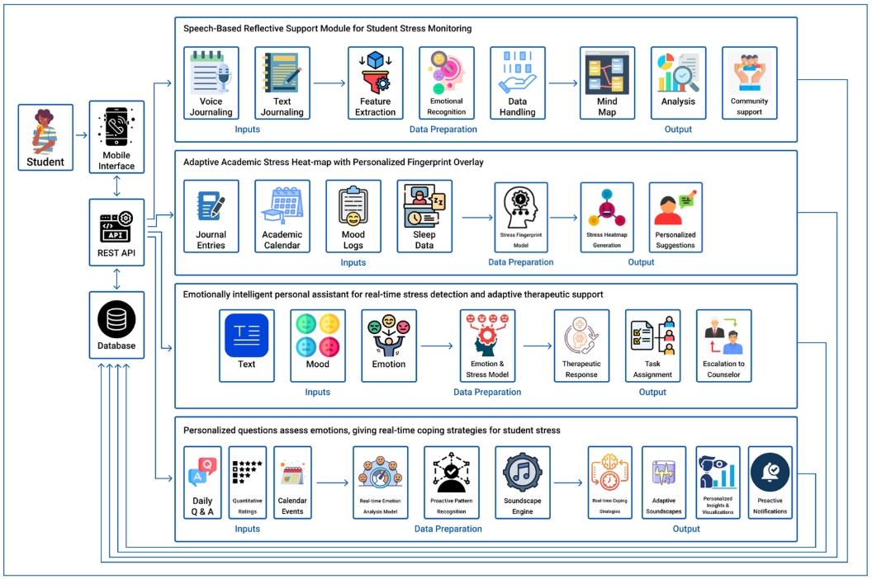
SELF-MONITORING AND ANONYMOUS COUNSELLING BASED DIGITAL COMPANION FOR ACADEMIC STRESS MANAGEMENT
[IT22315632]
[IT22358684]
SYSTEM ARCHITECTURE
[IT22341136]
[IT22004390]
25-26J-480

Slide 9




SELF-MONITORING AND ANONYMOUS COUNSELLING BASED DIGITAL COMPANION FOR ACADEMIC STRESS MANAGEMENT
DEPLOYMENT / RUNTIME SETUP
FRONTEND
BACKEND
React Native
Firebase Cloud Services
ML PROCESSING
ARCHITECTURE
Python-based service
Cloud-based client–server system
25-26J-480
9

Slide 10


SELF-MONITORING AND ANONYMOUS COUNSELLING BASED DIGITAL COMPANION FOR ACADEMIC STRESS MANAGEMENT
COMMERCIALIZATION
MIND+
Market Size
JUST FOR A MONTHLY SUBCRIPTION
Growing demand for digital mental health and wellness applications
Large and expanding student population with increasing reliance on mobile-based support tools
Strong adoption potential within higher education institutions and wellness programs
Session 01
Special Sessions
5000 LKR
10000 LKR
2000 LKR
Session 02
Session 04
2000 LKR
Session 03
2000 LKR
25-26J-480

Slide 11
SELF-MONITORING AND ANONYMOUS COUNSELLING BASED DIGITAL COMPANION FOR ACADEMIC STRESS MANAGEMENT
COST & FEASIBILITY ANALYSIS
Estimated Development Cost
Hardware (Laptops / Mobile Devices) – 50,000 LKR
Software & APIs (Firebase, Voice Emotion API) – 40,000 LKR
Domain & Hosting Services – 15,000 LKR
External Consultation (Mental Health Expert) – 25,000 LKR
Testing & Data Collection Tools – 20,000 LKR
Operational Costs (Transportation & Stationery) – 10,000 LKR
Total Estimated Cost: 160,000 LKR
Technical Feasibility: Uses existing AI, NLP, and cloud-based technologies.
Economic Feasibility: Majority of development tools are open-source and cost-efficient.
Operational Feasibility: Designed to support students in managing academic stress effectively.
Schedule Feasibility: Project development is ~90% completed and progressing within the planned timeline.
25-26J-480

Slide 12
SELF-MONITORING AND ANONYMOUS COUNSELLING BASED DIGITAL COMPANION FOR ACADEMIC STRESS MANAGEMENT
ADOPTION PLAN & NEXT STEPS
Pilot Testing: Deploy among a small group of university students
Evaluation: Collect feedback and improve system performance
Partnership: Collaborate with universities and counseling centers
Rollout: Expand deployment as a student mental wellness platform
25-26J-480

Slide 13
SELF-MONITORING AND ANONYMOUS COUNSELLING BASED DIGITAL COMPANION FOR ACADEMIC STRESS MANAGEMENT
DEMO PLAN
Hettiarachchi E.I. Daily Monitoring Demonstrates mood calculation, and
IT22004390 recommendations
Gunathilaka M.A.S. Anonymous Counseling Demonstrates real-time chat and
IT22341136 intervention suggestions
Raajapaksha R.N.D.K. Voice Journaling Demonstrates audio recording and
IT22315632 stress keyword detection
Jayasooriya J.K.B.A.P. Adaptive Stress Heatmap Demonstrates stress prediction and IT22358684 heatmap visualization
25-26J-480

Slide 14
THANK YOU

